Slide 1

DESIGN THINKING रचना कि सोच

Slide 2
Agenda
What is Design Thinking?
5 Steps of Design Thinking
Activity Time – Design a Wallet
Activity Time – Upcycling Activity
Look Around

Slide 3


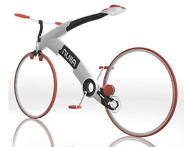
देखिये और जानिये
Cup & Saucer
Book Shelf
Bicycle
Notes:
Lets Observe and analyze these designs :
What can you see?
How are these designs different from the standard designs of these products?
This is Design. (not more than 2 sentences about design)

Slide 4
What is Design Thinking? क्या है डिजाइन थिंकिंग?
Sensibility of Designer
People’s Needs
Technological Feasibility
एक नजरिया जो मुश्कील को हल कर सके|

Slide 5
Design Thinking Rules
The Human Rule
The Ambiguity Rule
The Tangibility Rule
The Re-design Rule
Notes:
The human rule, which states that all design activity is ultimately social in nature, and any social innovation will bring us back to the 'human-centric point of view'.
The ambiguity rule, in which design thinkers must preserve ambiguity by experimenting at the limits of their knowledge and ability, enabling the freedom to see things differently.
The re-design rule, where all design is re-design; this comes as a result of changing technology and social circumstances but previously solved, unchanged human needs.
The tangibility rule, the concept that making ideas tangible always facilitates communication and allows designers to treat prototypes as 'communication media'.

Slide 6
FIVE STEPS OF DESIGN THINKING
EMPATHIZE
IDEATE
DEFINE
PROTOTYPE
TEST
समवेदना और
समानुभूती
सोच विचार करना
निश्चित करना
प्रतिकृती बनाना
जांच करना

Slide 7
कुछ और
Design Thinking Examples
The Problem
Moment of Truth
Dark Houses
Lit Houses

Slide 8


Slide 9
धन्यवाद

